Slide 1

Data Engineer Assignment
Kwan Jun Hao

Slide 2
Problem Statement
Git Repository Commit Points
Who commits the most?
Who has the longest streak?
Commits heatmap

Slide 3
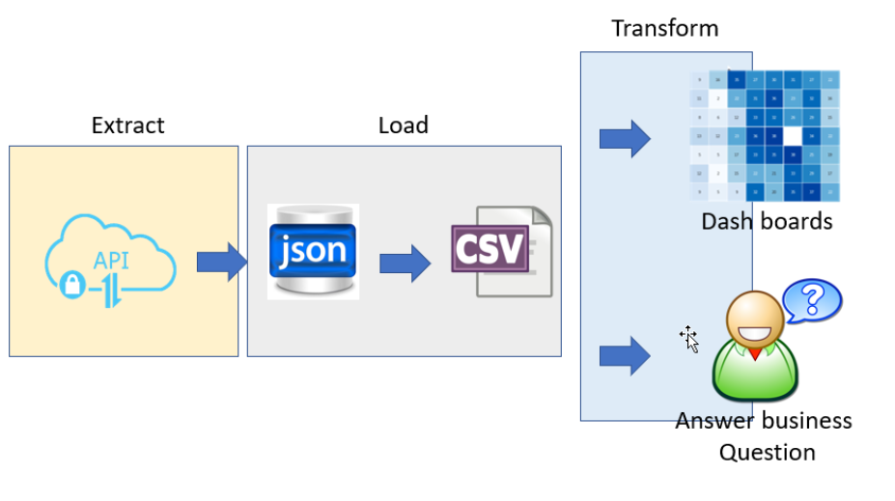
High-Level Overall Architect (ELT)

Slide 4
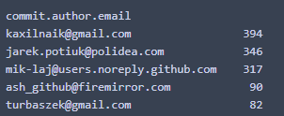
Top 5 Commit / Top commit steak

Slide 5
